Slide 1
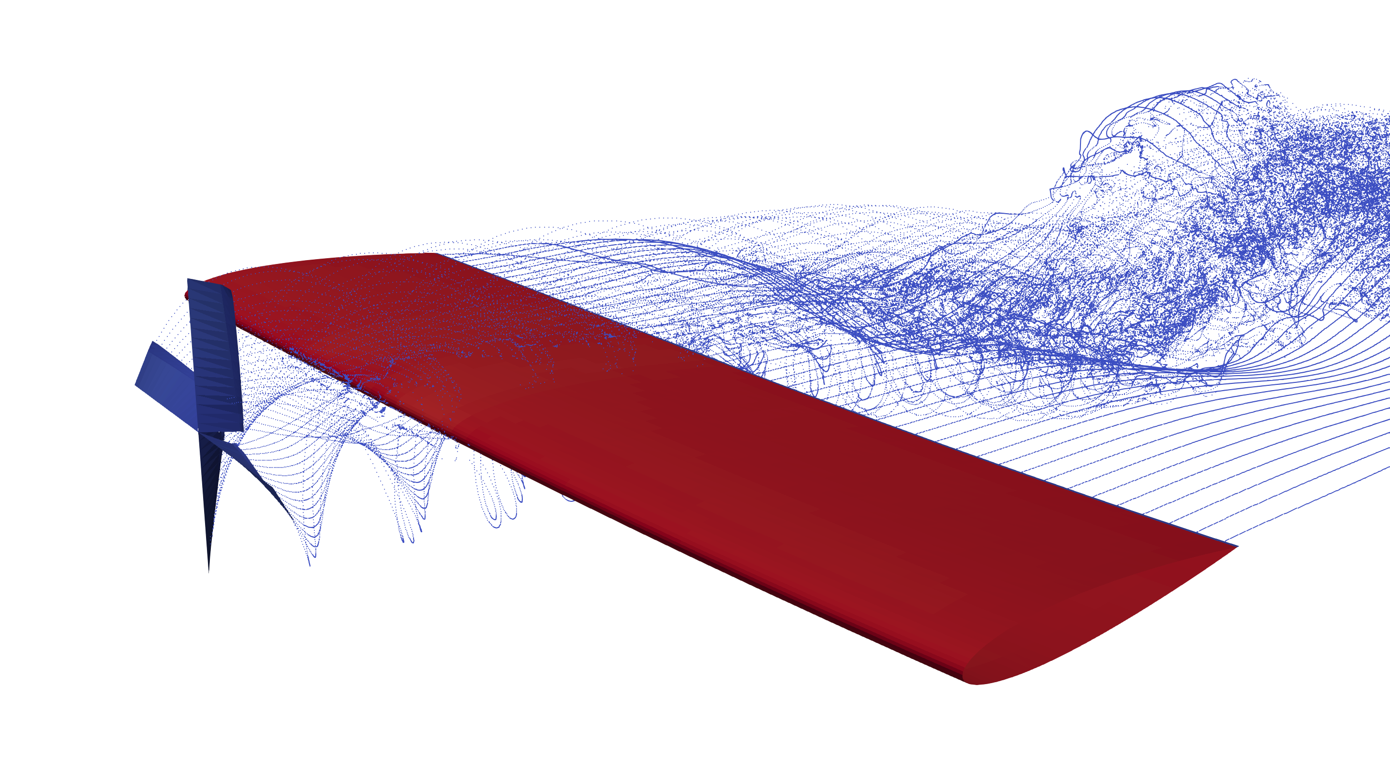
Aerodynamic Investigation of Propeller-Wing Interaction for Simple Motions and Complex Modes
Colloquium
Shreyas Ashwin Sunder
FH Aachen
30.09.2024
Supervisors:
Prof. Carsten Braun
Nils Böhnisch M.Sc.

Slide 2
Workflow
Thesis Objectives
Fundamentals
Simulation Methodology
Aerodynamic Investigation:
Simple Motions
Aerodynamic Investigation:
Complex Modes
Conclusions and Outlook

Slide 3
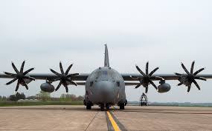
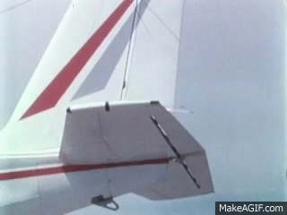
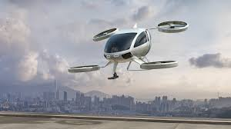
Introduction
Propellers, once seen as outdated, are now key in modern aircraft design.
Increasing relevance due to electric propulsion systems and urban air mobility (eVTOLs, air taxis).
Critical for optimising aerodynamic performance in new aircraft designs.
Important for maintaining aircraft stability and structural integrity by avoiding flutter and divergence.
Present research on propeller-wing interaction is focused on stationary conditions. Very little research has been done on propeller-wing interaction on dynamic systems.

Slide 4
Thesis Objectives
Primary Objectives:
To investigate the aerodynamic performance of wings undergoing pure-pitching and pure-plunging motions with a:
Rigidly attached propeller
Flexibly attached propeller
To present the results of simulations performed on a flexible wing with a rigidly attached propeller undergoing its 1st natural bending and torsional wing modes.
Secondary Objectives:
To develop a tool in MATLAB using a novel framework that allows a user to assign prescribed motions to a model.
To couple the tool to an aerodynamic solver (DUST) using a coupling library (preCICE).

Slide 5
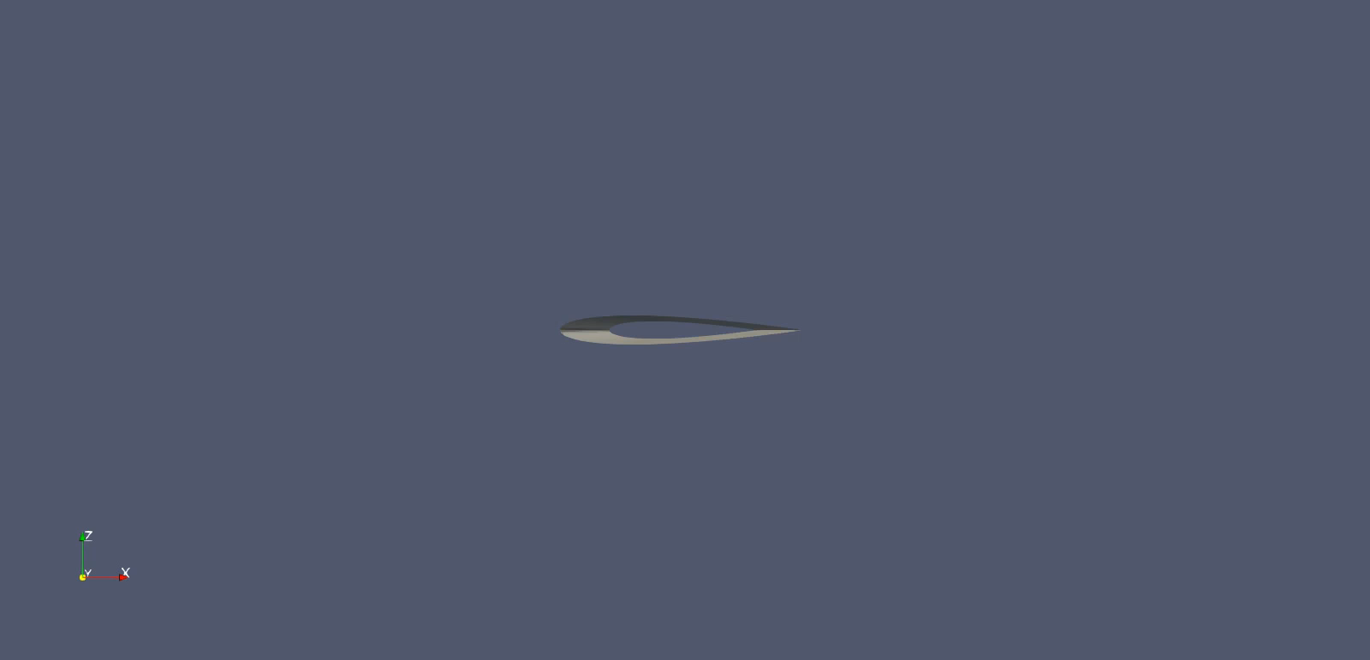
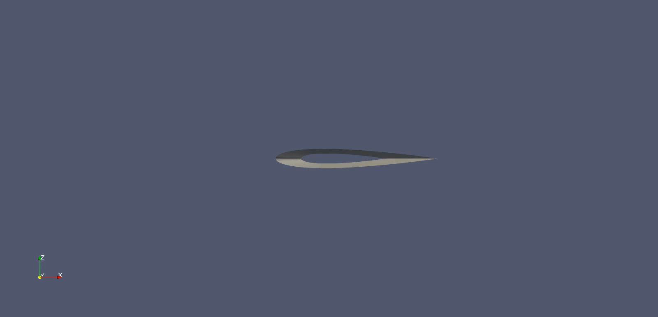
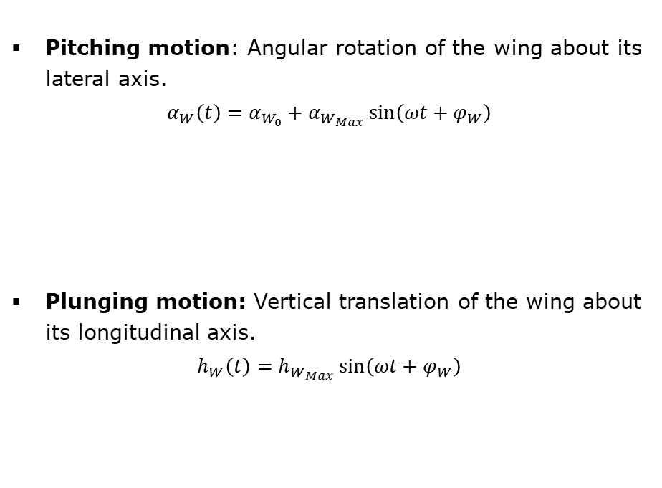
Fundamentals
Simple Wing Motions
Pitching motion: Angular rotation of the wing about its lateral axis.
$$α_{W}\left(t\right)=α_{W_{0}}+α_{W_{Max}}\sin\left(ωt+φ_{W}\right)$$
Plunging motion: Vertical translation of the wing about its longitudinal axis.
$$h_{W}\left(t\right)=h_{W_{Max}}\sin\left(ωt+φ_{W}\right)$$
Pure pitching motion
Pure plunging motion

Slide 6
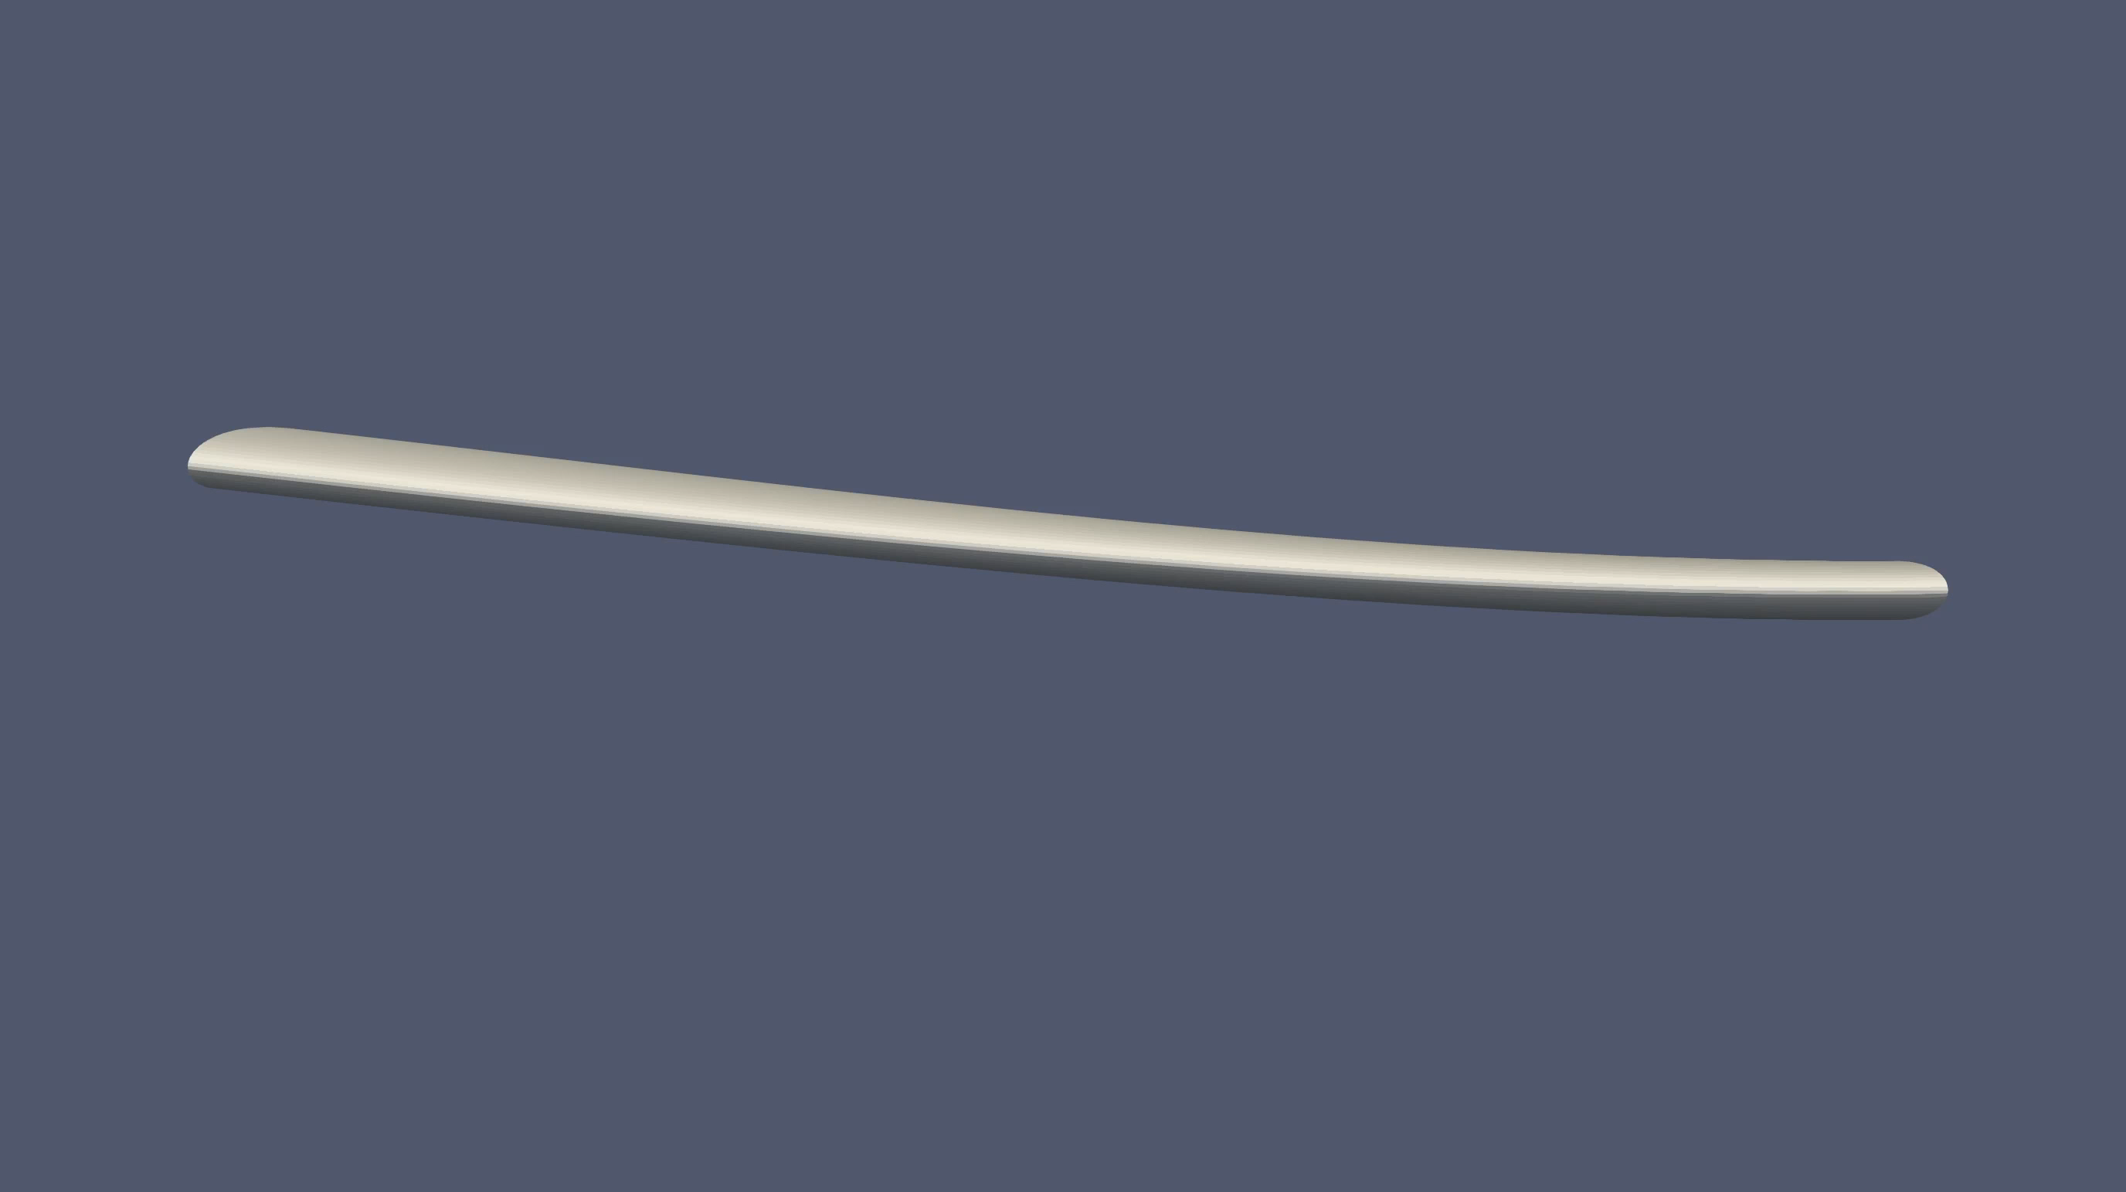
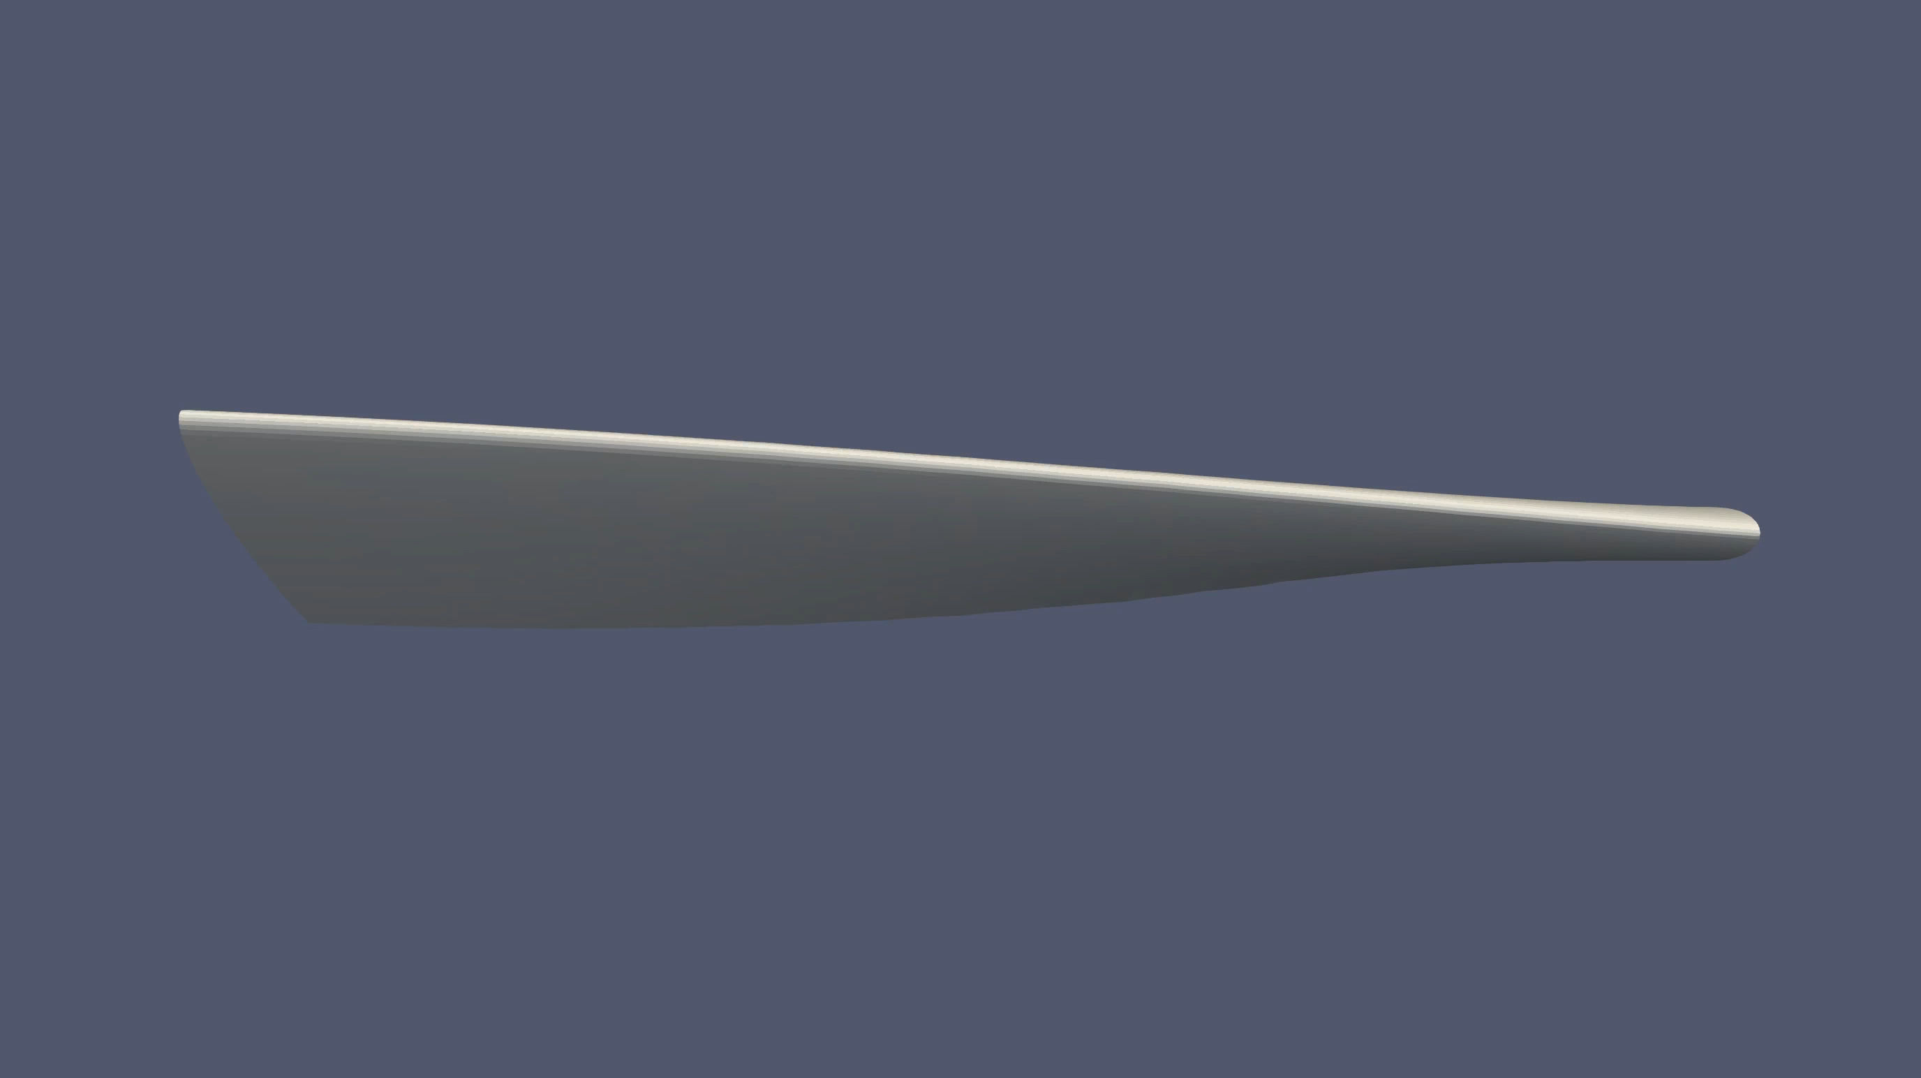
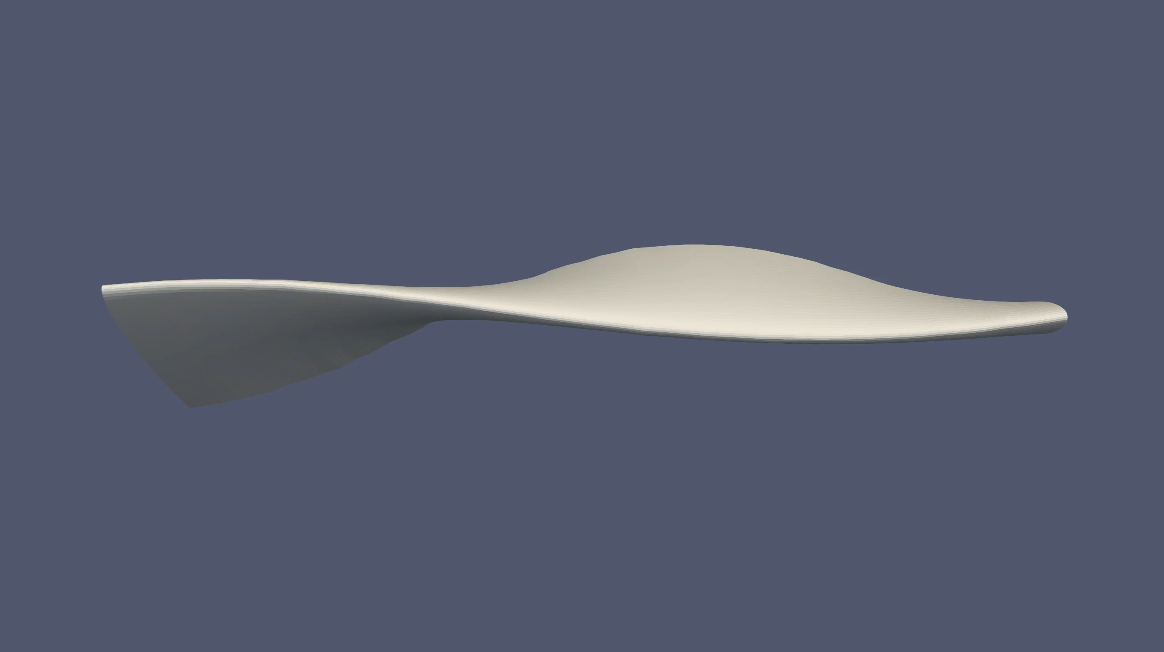
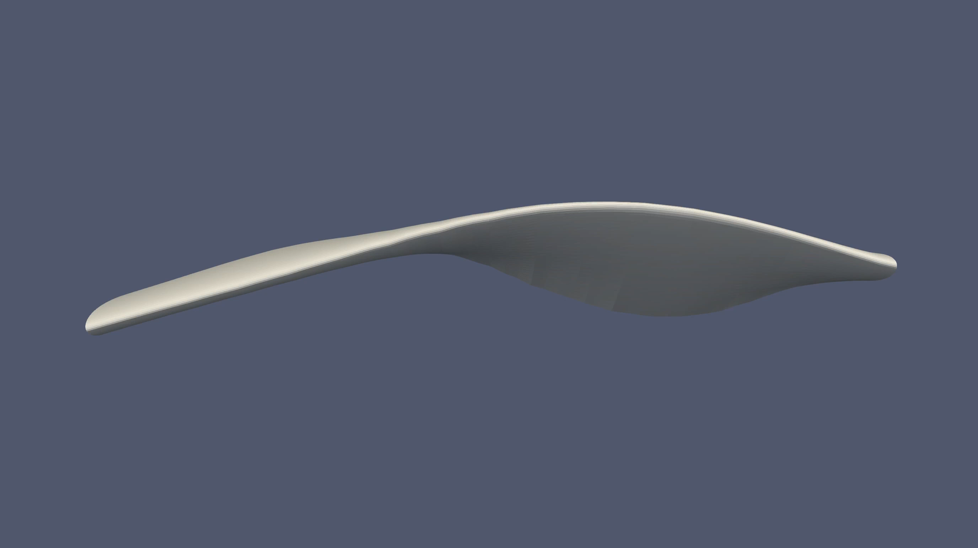
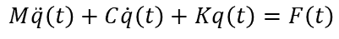

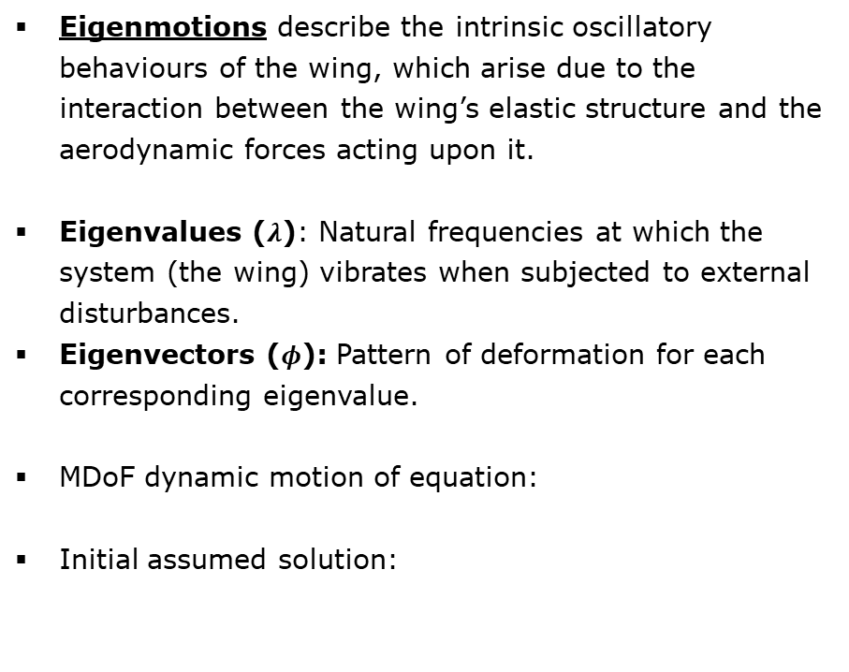
Fundamentals
Complex Wing Modes
Eigenmotions describe the intrinsic oscillatory behaviours of the wing, which arise due to the interaction between the wing’s elastic structure and the aerodynamic forces acting upon it.
Eigenvalues ($λ$): Natural frequencies at which the system (the wing) vibrates when subjected to external disturbances.
Eigenvectors ($φ$): Pattern of deformation for each corresponding eigenvalue.
MDoF dynamic motion of equation:
Initial assumed solution:
Bending dominated
Torsional dominated
Bending-Torsion dominated
Bending-Torsion dominated
$$M\ddot{q}\left(t\right)+C\dot{q}\left(t\right)+Kq\left(t\right)=F\left(t\right)$$
$$q\left(t\right)=φe^{λt}$$

Slide 7
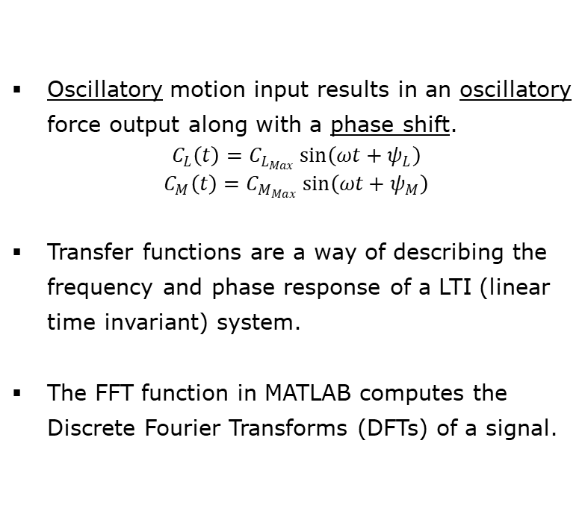
Fundamentals
Analysis of Resulting Forces
Oscillatory motion input results in an oscillatory force output along with a phase shift.
$$C_{L}\left(t\right)=C_{L_{Max}}\sin\left(ωt+ψ_{L}\right)$$
$$C_{M}\left(t\right)=C_{M_{Max}}\sin\left(ωt+ψ_{M}\right)$$
Transfer functions are a way of describing the frequency and phase response of a LTI (linear time invariant) system.
The FFT function in MATLAB computes the Discrete Fourier Transforms (DFTs) of a signal.
Pitching motion - $C_{L}$ output example
FFT output of a sample input signal

Slide 8
Simulation Methodology
Partitioned Fluid-Motion Interaction (FMI) Simulations
Partitioned simulations involve two or more individual solvers as opposed to monolithic simulations (Ex. CFD solvers).
Output from fluid solver is a response to a pre-defined motion, i.e., a motion response instead of a structural response (partitioned fluid-structure interaction (FSI) simulations).
Fluid/Aerodynamic solver: DUST
Coupling Library: preCICE
Coupling Library (preCICE)
”Motion”
Solver
Input:
Forces, Moments
Output:
Positions, Velocities
Aerodynamic
Solver (DUST)
Input:
Positions, Velocities
Output:
Forces, Moments

Slide 9
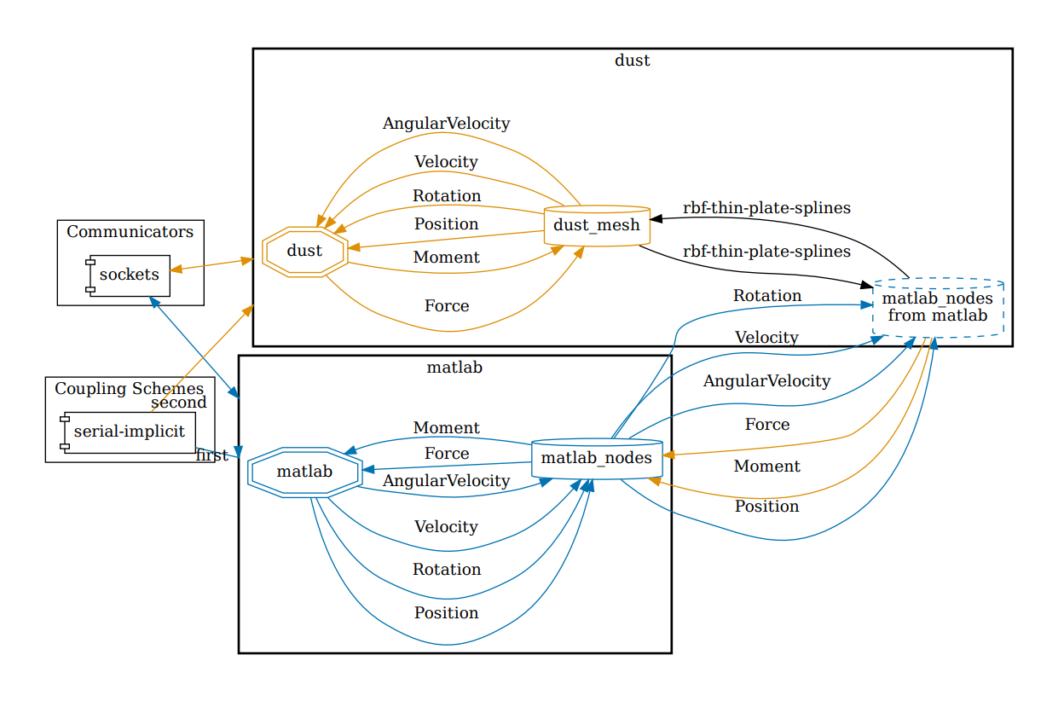
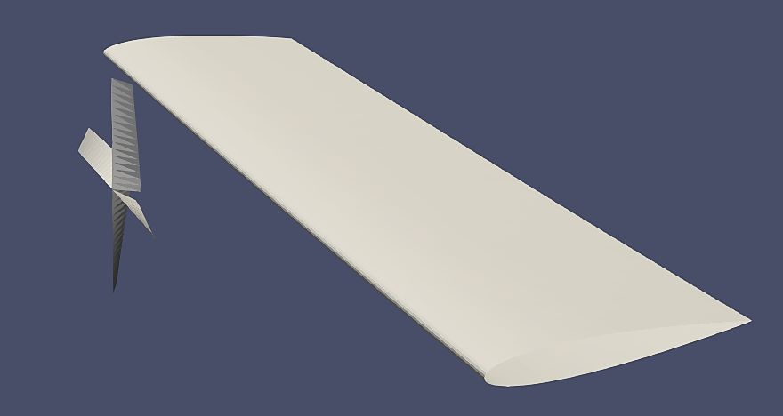
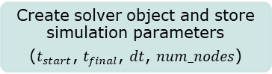
Simulation Methodology
Motion Solver
FMI simulation
Create solver object and store simulation parameters
($t_{start}$, $t_{final}$, $dt$, $num_nodes$)
Define reference frames and assign coupling nodes to their respective reference frames
Max Time:
1min
Global
Define prescribed motions and assign to the reference frames
Wing
(Coupling Nodes=9)
Calculate positions and velocities of all DoFs for each node in each time step
Pivot Point
Initialise adapter and begin coupling with DUST
Z
Max Time:
0.2s
Y
X
Propeller
(Coupling Nodes=4)

Slide 10
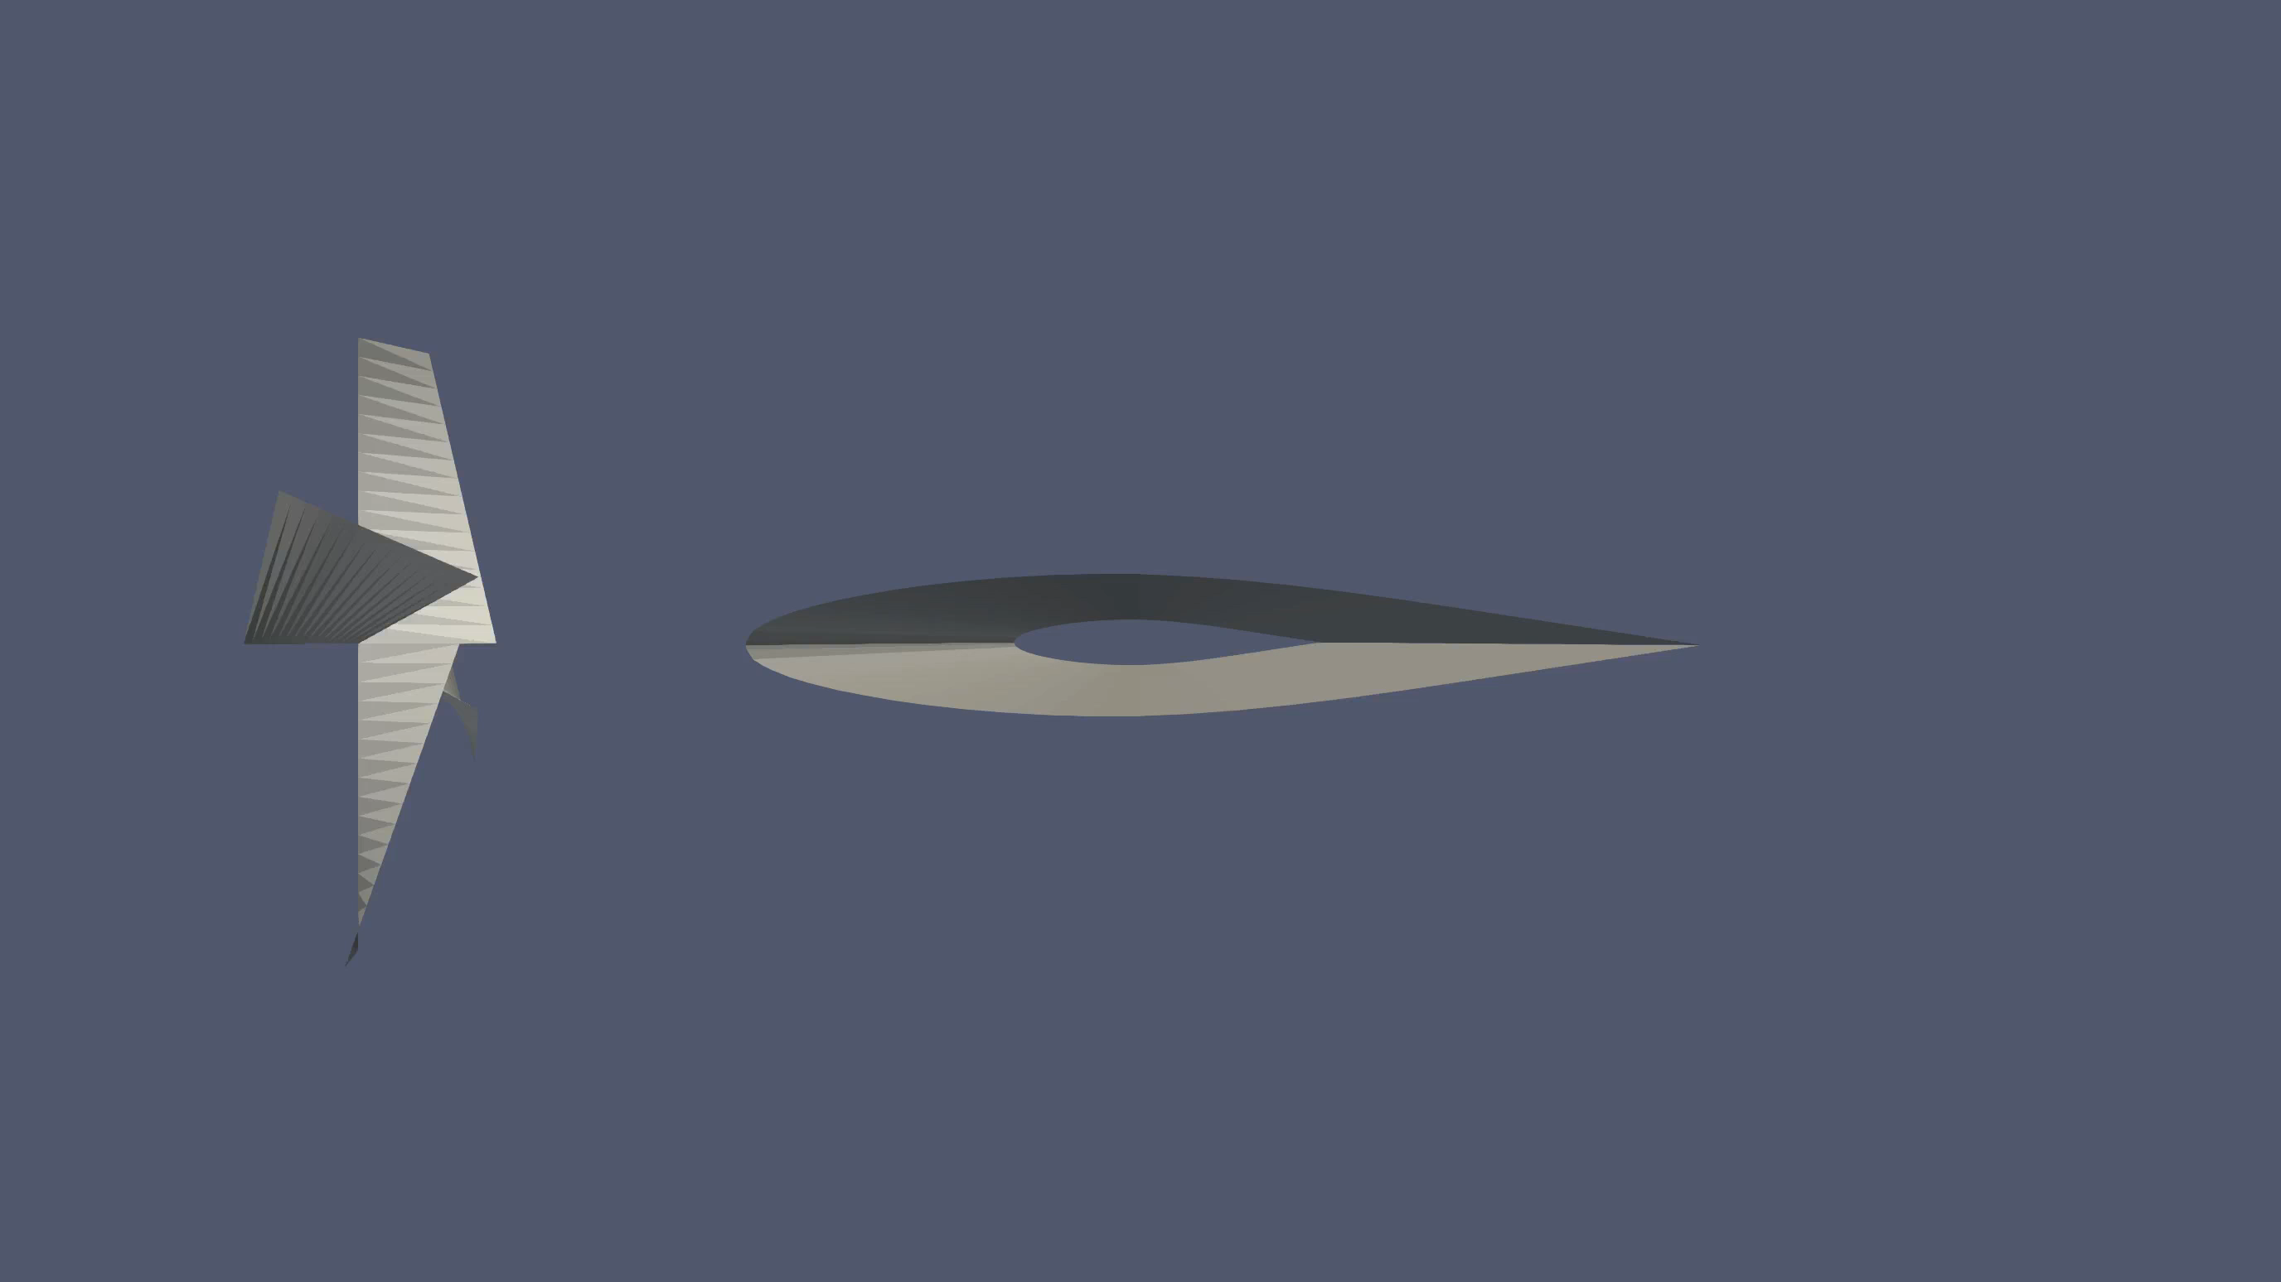

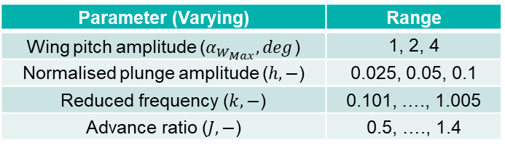
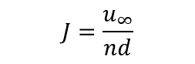
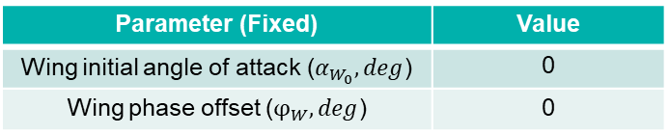
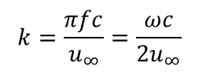
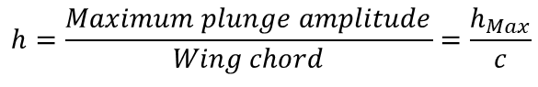
Aerodynamic Investigation: Simple Motions
Rigidly Attached Propeller
Parameter (Fixed) | Value
Wing initial angle of attack ($α_{W_{0}}, deg$) | 0
Wing phase offset ($φ_{W}, deg$) | 0
Parameter (Varying) | Range
Wing pitch amplitude ($α_{W_{Max}}, deg$) | 1, 2, 4
Normalised plunge amplitude ($h, −$) | 0.025, 0.05, 0.1
Reduced frequency ($k, −$) | 0.101, …., 1.005
Advance ratio ($J, −$) | 0.5, …., 1.4
Pitching motion
$$h=\frac{Maximum plunge amplitude}{Wing chord}=\frac{h_{Max}}{c}$$
$$k=\frac{πfc}{u_{∞}}=\frac{ωc}{2u_{∞}}$$
$$J=\frac{u_{∞}}{nd}$$
Plunging motion

Slide 11
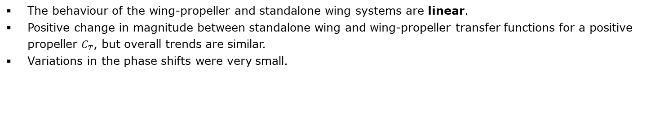
Aerodynamic Investigation: Simple Motions
Rigidly Attached Propeller – Wing Motion Variation
Pitching Wing – Lift (left) and Moment (right) transfer functions:
Complex plane representation; $J=0.9$, $C_{T}=0.133$
Plunging Wing – Lift (left) and Moment (right) transfer functions:
Complex plane representation; $J=0.9$, $C_{T}=0.133$
The behaviour of the wing-propeller and standalone wing systems are linear.
Positive change in magnitude between standalone wing and wing-propeller transfer functions for a positive propeller $C_{T}$, but overall trends are similar.
Variations in the phase shifts were very small.

Slide 12
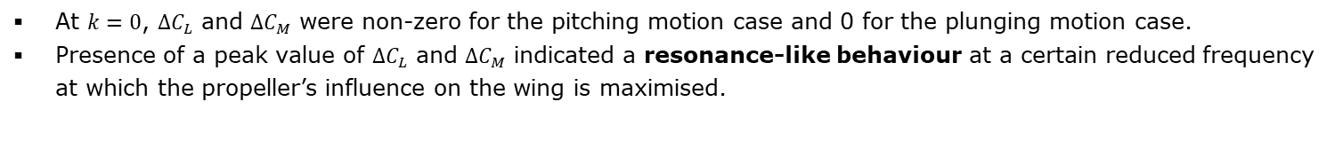
Aerodynamic Investigation: Simple Motions
Rigidly Attached Propeller – Wing Motion Variation
Pitching Wing – Lift (top) and Moment (bottom) force variation:
Magnitude (left) and phase (right) representation; $J=0.9$, $C_{T}=0.133$
Plunging Wing – Lift (top) and Moment (bottom) force variation:
Magnitude (left) and phase (right) representation; $J=0.9$, $C_{T}=0.133$
At $k=0$, $∆C_{L}$ and ${∆C}_{M}$ were non-zero for the pitching motion case and 0 for the plunging motion case.
Presence of a peak value of $∆C_{L}$ and ${∆C}_{M}$ indicated a resonance-like behaviour at a certain reduced frequency at which the propeller’s influence on the wing is maximised.

Slide 13
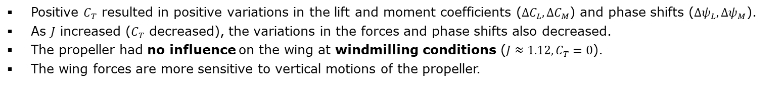
Aerodynamic Investigation: Simple Motions
Rigidly Attached Propeller – Propeller Settings Variation
Pitching Wing – Lift (top) and Moment (bottom) force variation:
Magnitude (left) and phase (right) representation; $α_{W_{Max}}=4°$
Plunging Wing – Lift (top) and Moment (bottom) force variation:
Magnitude (left) and phase (right) representation; $h=0.05$
Positive $C_{T}$ resulted in positive variations in the lift and moment coefficients ($∆C_{L},{∆C}_{M}$) and phase shifts ($∆ψ_{L}, ∆ψ_{M}$).
As $J$ increased ($C_{T}$ decreased), the variations in the forces and phase shifts also decreased.
The propeller had no influence on the wing at windmilling conditions ($J≈1.12,C_{T}=0$).
The wing forces are more sensitive to vertical motions of the propeller.

Slide 14
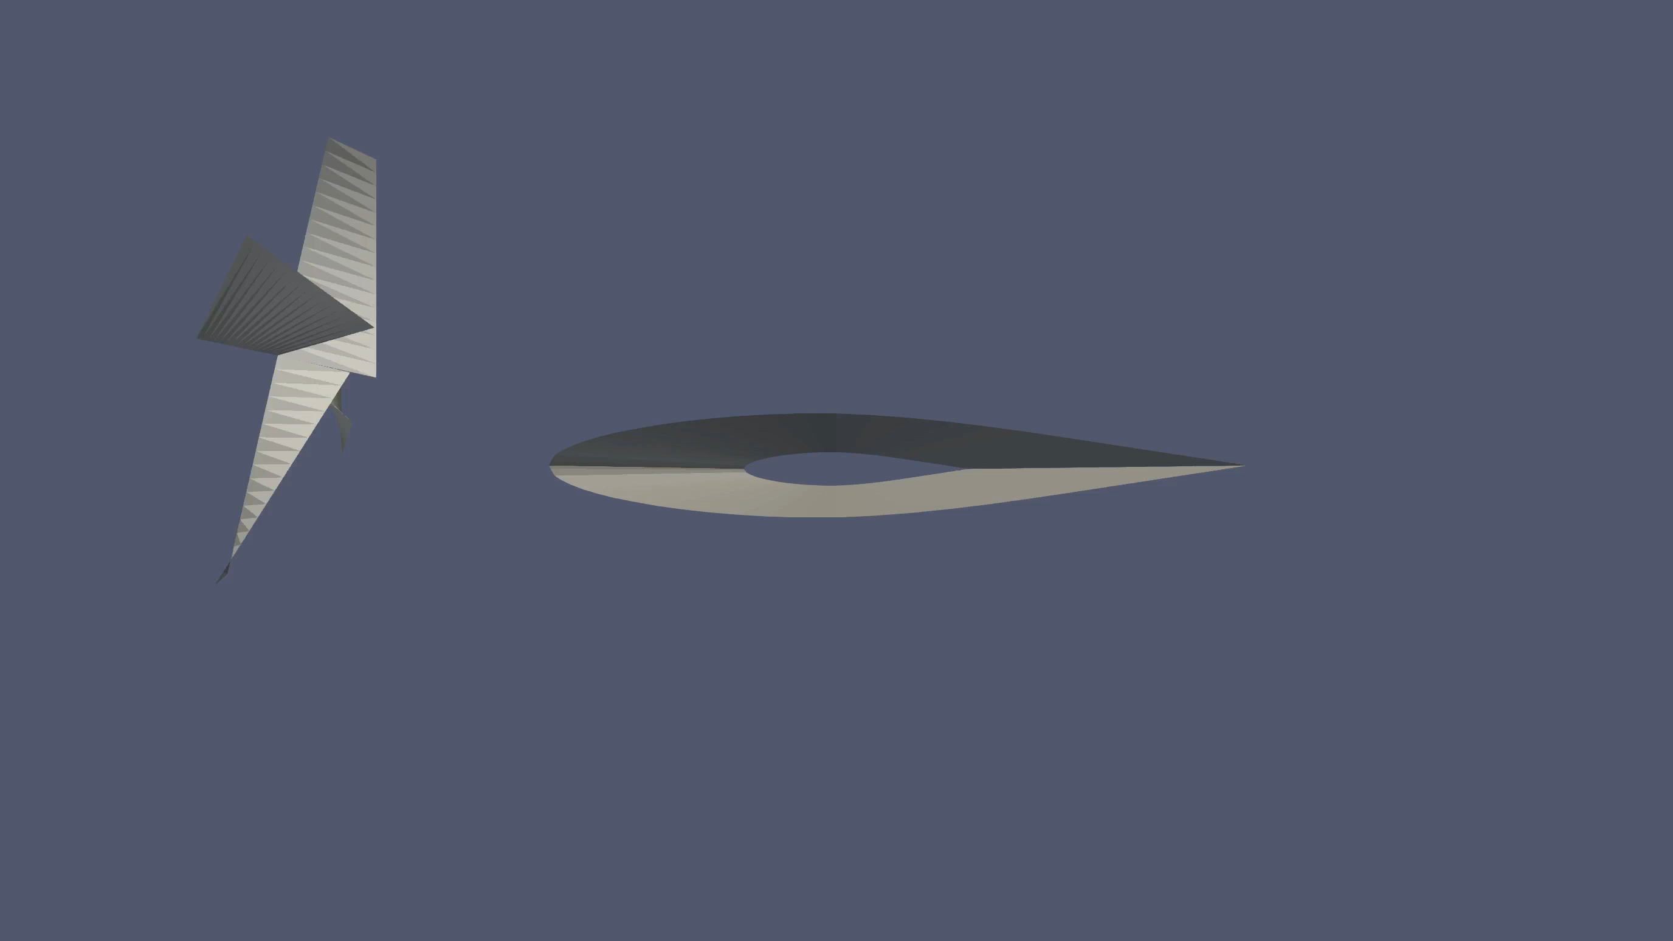

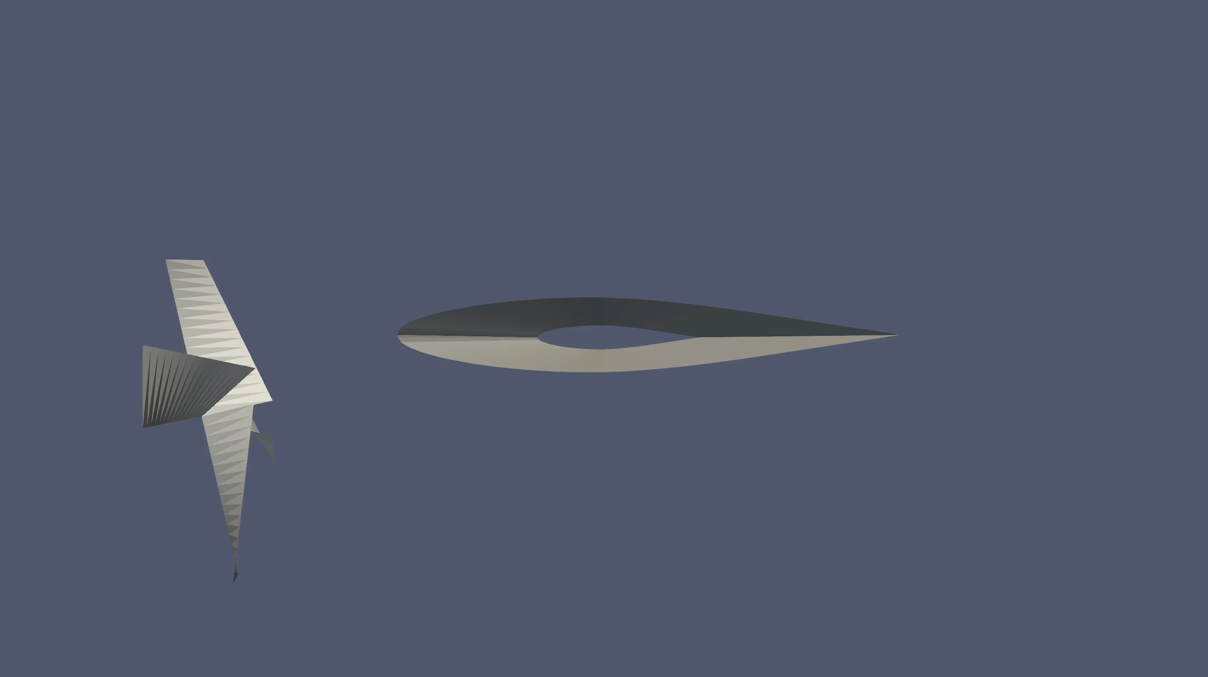
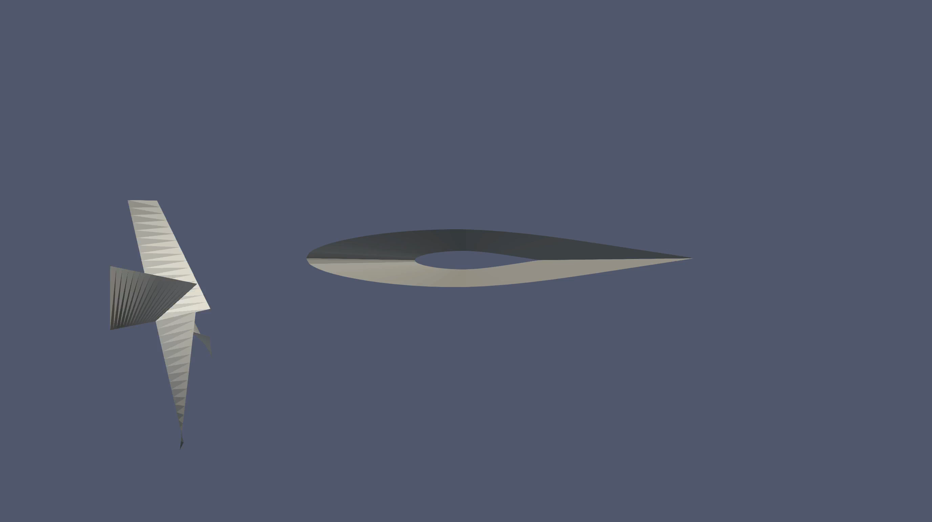
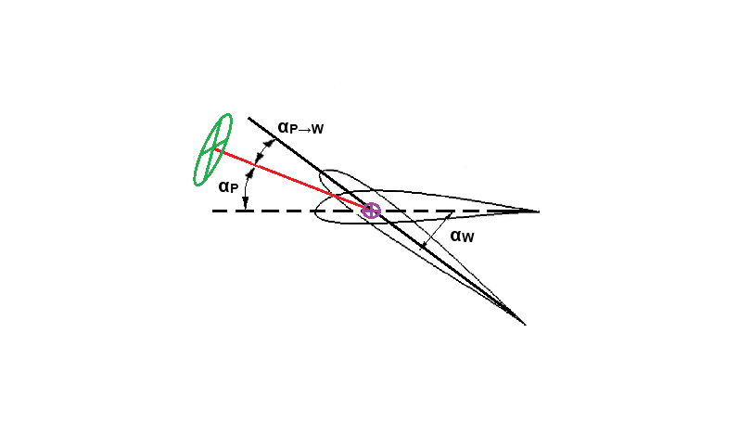
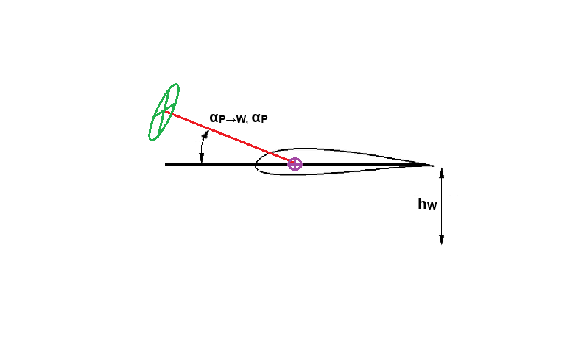
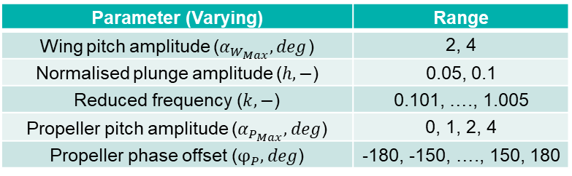
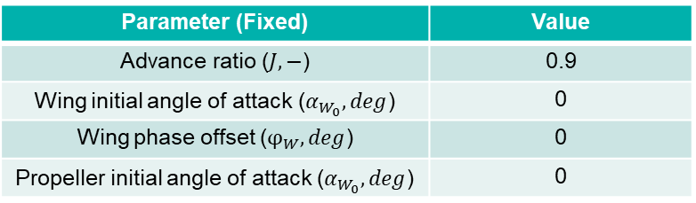
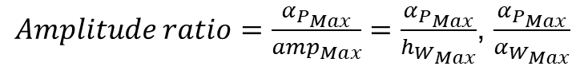
Aerodynamic Investigation: Simple Motions
Flexibly Attached Propeller
Parameter (Fixed) | Value
Advance ratio ($J, −$) | 0.9
Wing initial angle of attack ($α_{W_{0}}, deg$) | 0
Wing phase offset ($φ_{W}, deg$) | 0
Propeller initial angle of attack ($α_{W_{0}}, deg$) | 0
Pitching motion – Phase Lead
Plunging motion – Phase Lead
Parameter (Varying) | Range
Wing pitch amplitude ($α_{W_{Max}}, deg$) | 2, 4
Normalised plunge amplitude ($h, −$) | 0.05, 0.1
Reduced frequency ($k, −$) | 0.101, …., 1.005
Propeller pitch amplitude ($α_{P_{Max}}, deg$) | 0, 1, 2, 4
Propeller phase offset ($φ_{P}, deg$) | -180, -150, …., 150, 180
Pitching motion – Phase Lag
Plunging motion – Phase Lag
$$α_{P→W}\left(t\right)=α_{{P→W}_{0}}+α_{P_{Max}}\sin\left(ωt+φ_{P}\right)$$
$Amplitude ratio=\frac{α_{P_{Max}}}{{amp}_{Max}}=\frac{α_{P_{Max}}}{h_{W_{Max}}}$, $\frac{α_{P_{Max}}}{α_{W_{Max}}}$

Slide 15
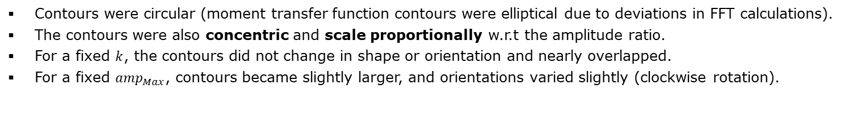
Aerodynamic Investigation: Simple Motions
Flexibly Attached Propeller
Pitching Wing – Lift (left) and Moment (right) transfer functions:
Complex plane representation (Flexible vs Rigid)
Plunging Wing – Lift (left) and Moment (right) transfer functions:
Complex plane representation (Flexible vs Rigid)
Contours were circular (moment transfer function contours were elliptical due to deviations in FFT calculations).
The contours were also concentric and scale proportionally w.r.t the amplitude ratio.
For a fixed $k$, the contours did not change in shape or orientation and nearly overlapped.
For a fixed ${amp}_{Max}$, contours became slightly larger, and orientations varied slightly (clockwise rotation).

Slide 16
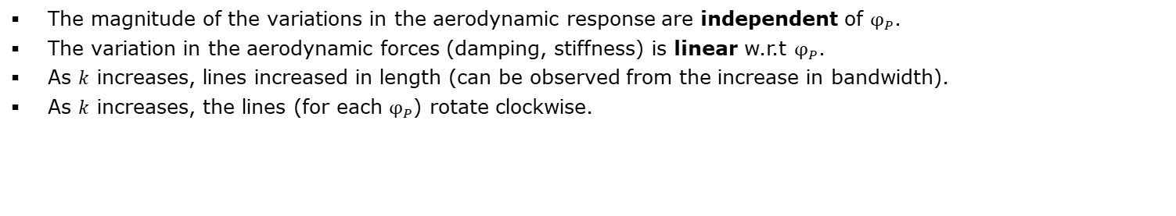
Aerodynamic Investigation: Simple Motions
Flexibly Attached Propeller
Pitching Wing – Lift (left) and Moment (right) transfer functions:
Complex plane representation; $α_{W_{Max}}=4°,α_{P_{Max}}=4$°
Plunging Wing – Lift (left) and Moment (right) transfer functions:
Complex plane representation; $h=0.05,α_{P_{Max}}=4$°
The magnitude of the variations in the aerodynamic response are independent of $φ_{P}$.
The variation in the aerodynamic forces (damping, stiffness) is linear w.r.t $φ_{P}$.
As $k$ increases, lines increased in length (can be observed from the increase in bandwidth).
As $k$ increases, the lines (for each $φ_{P}$) rotate clockwise.

Slide 17
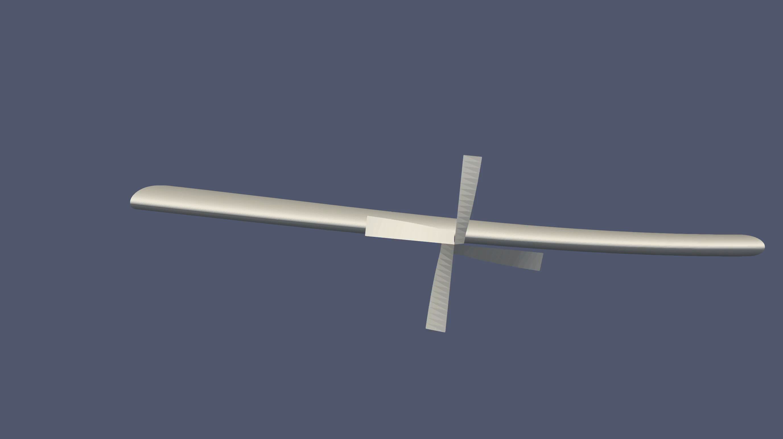
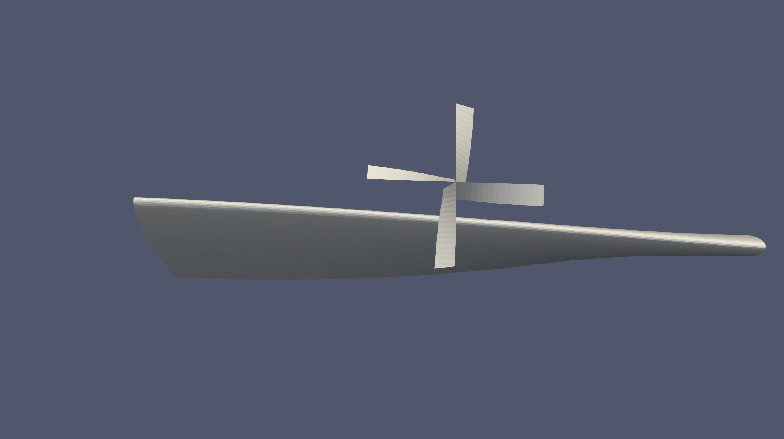
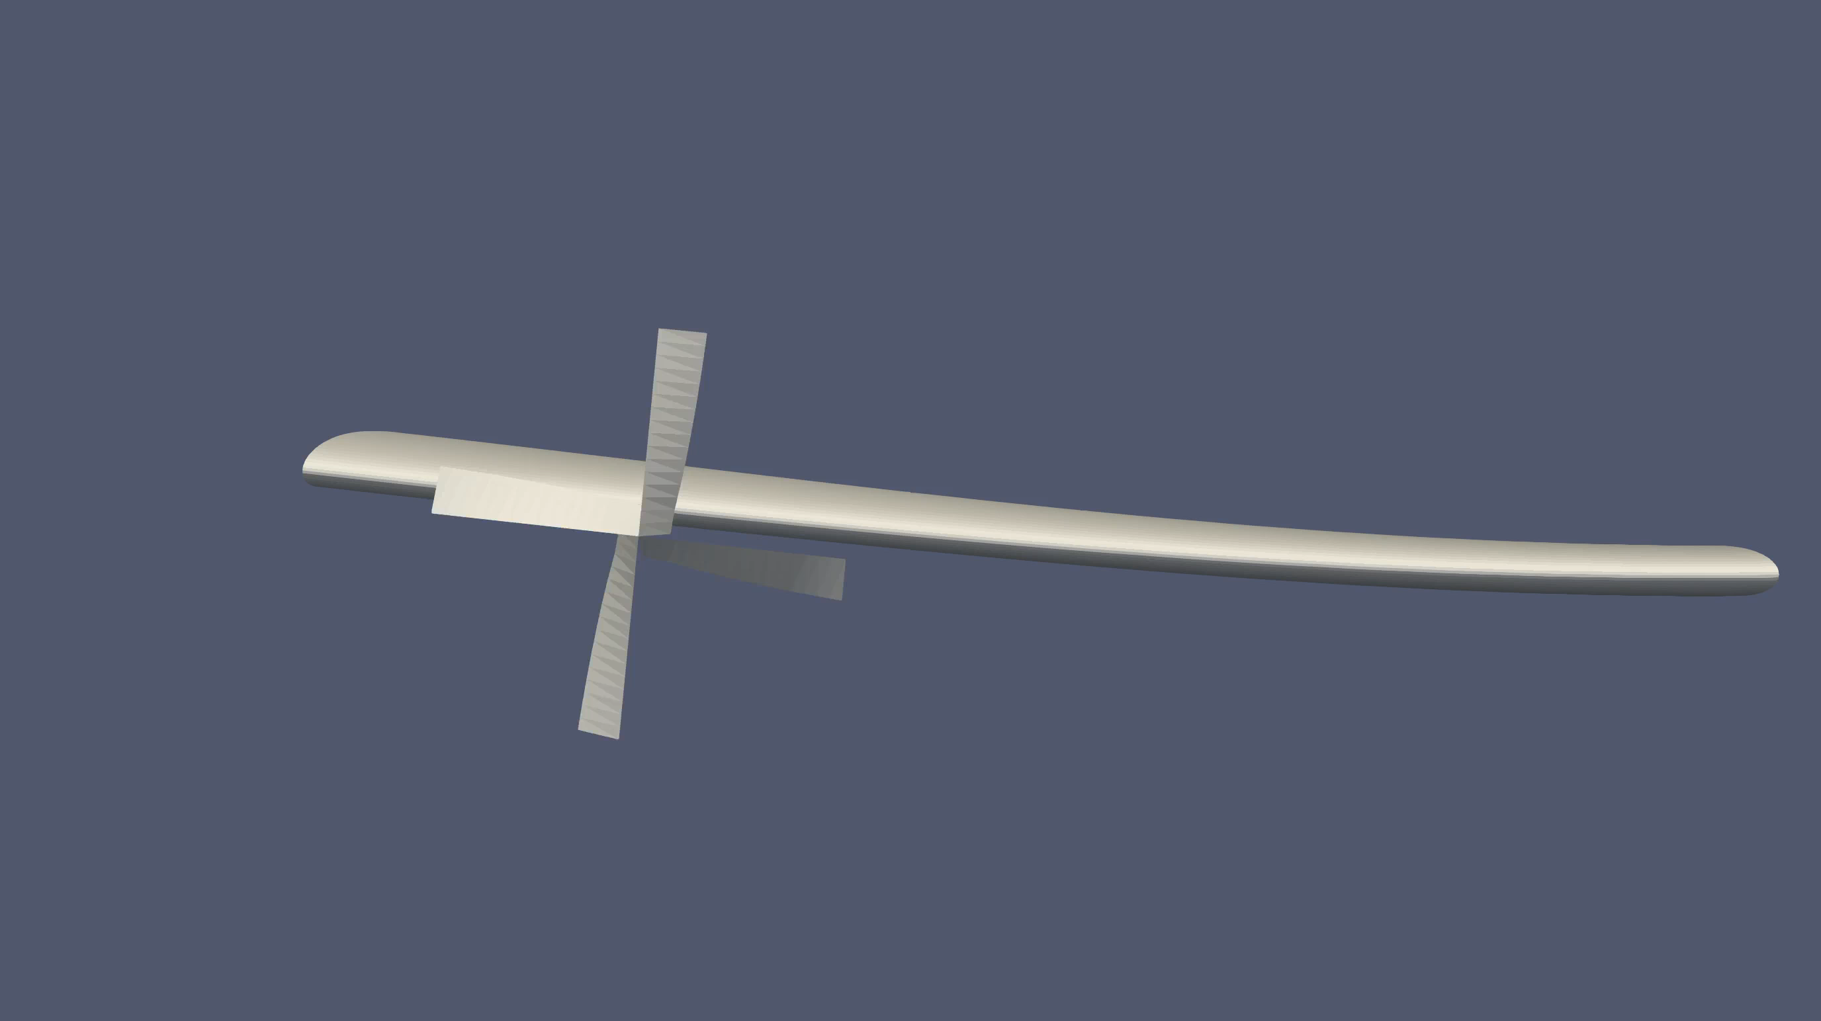
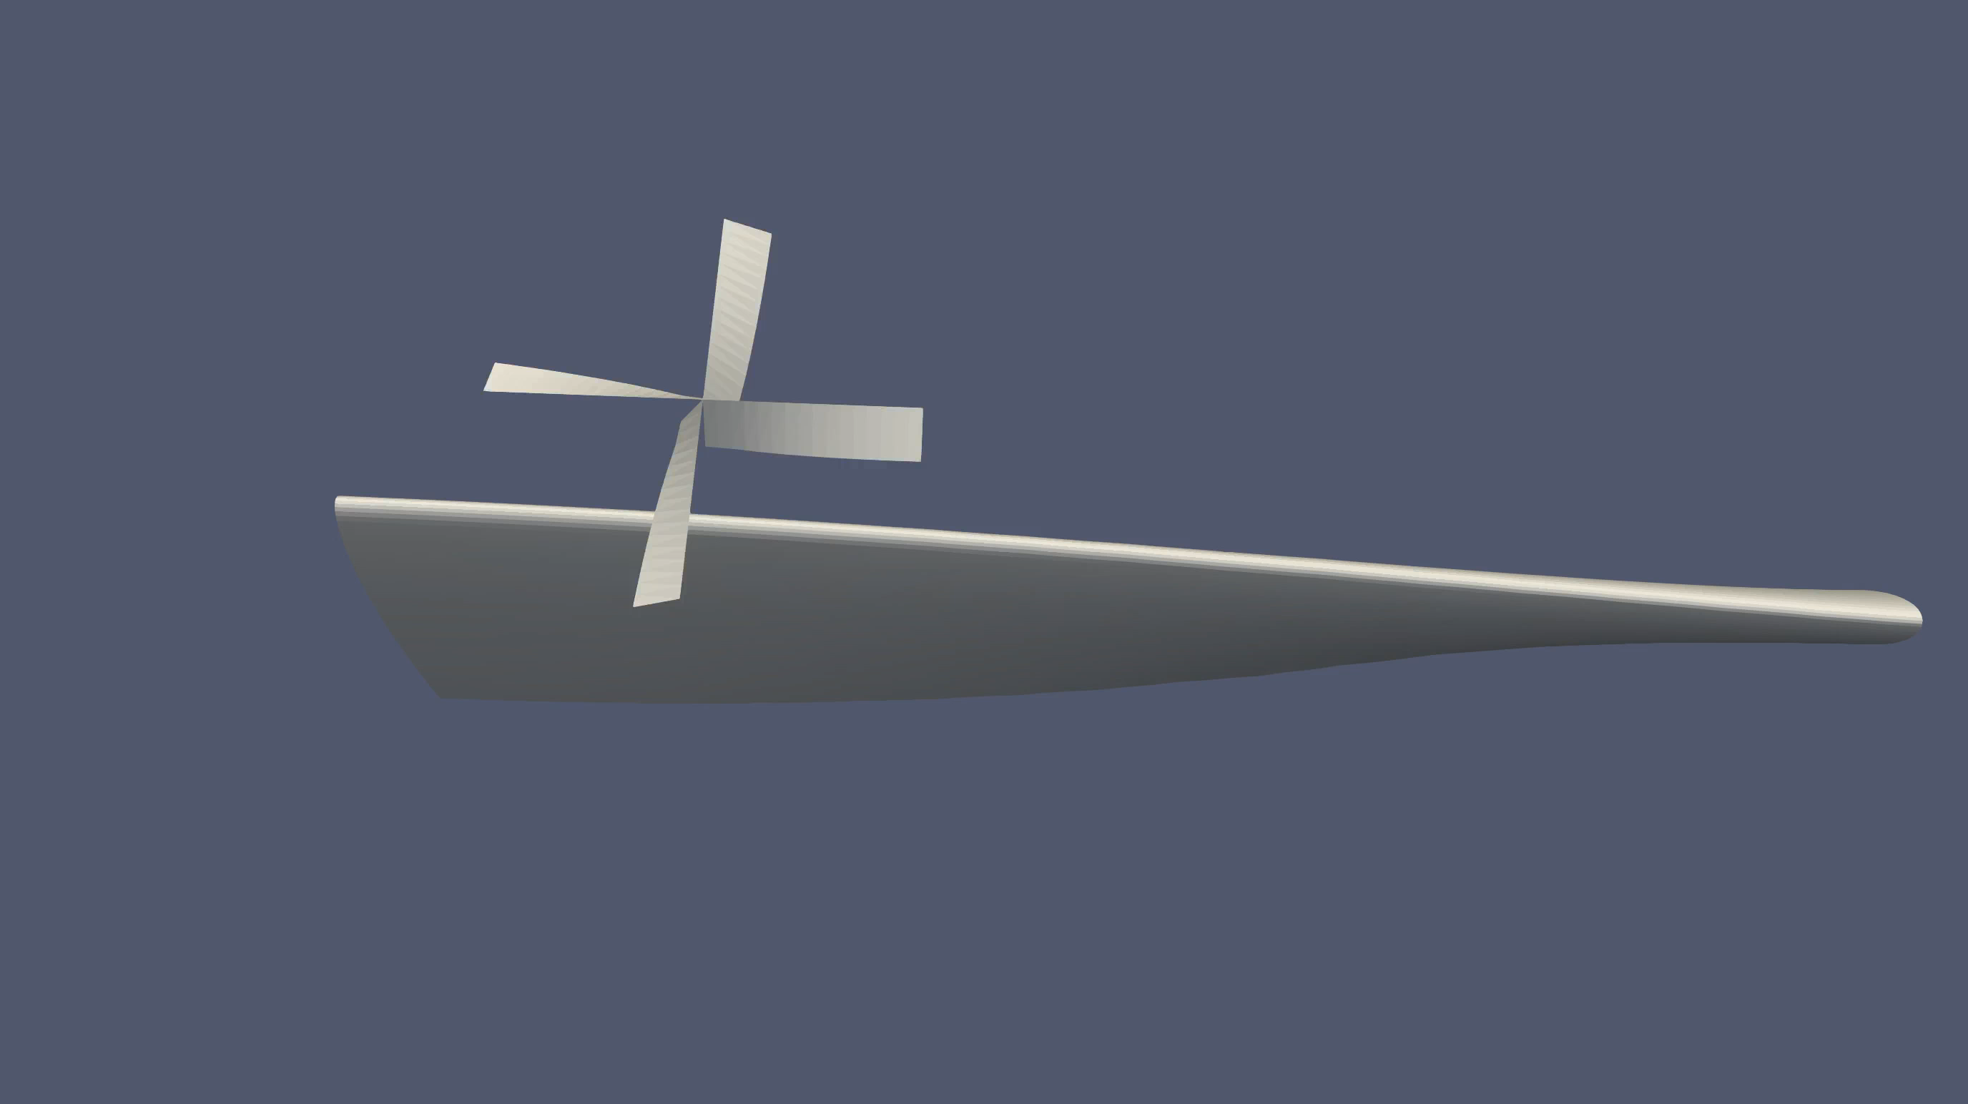
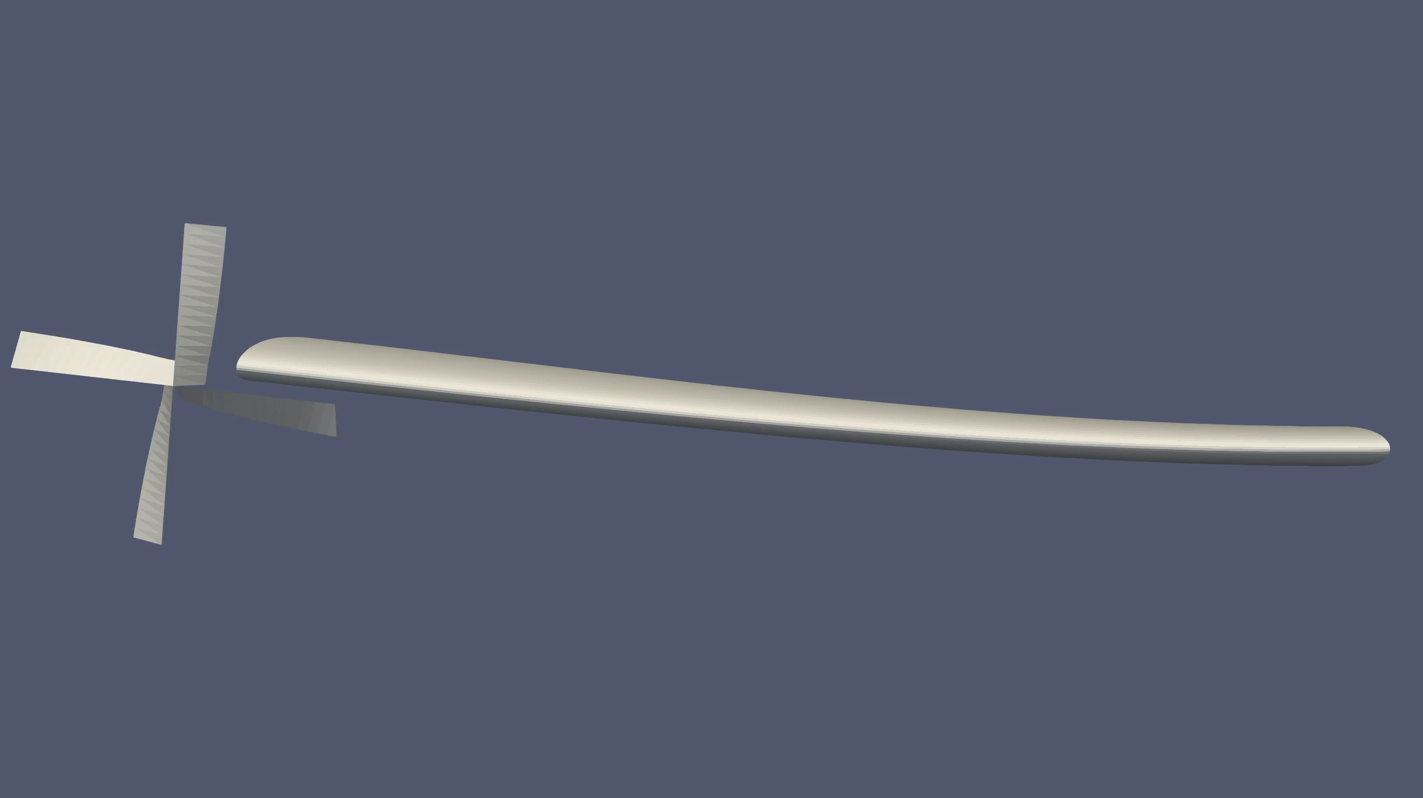
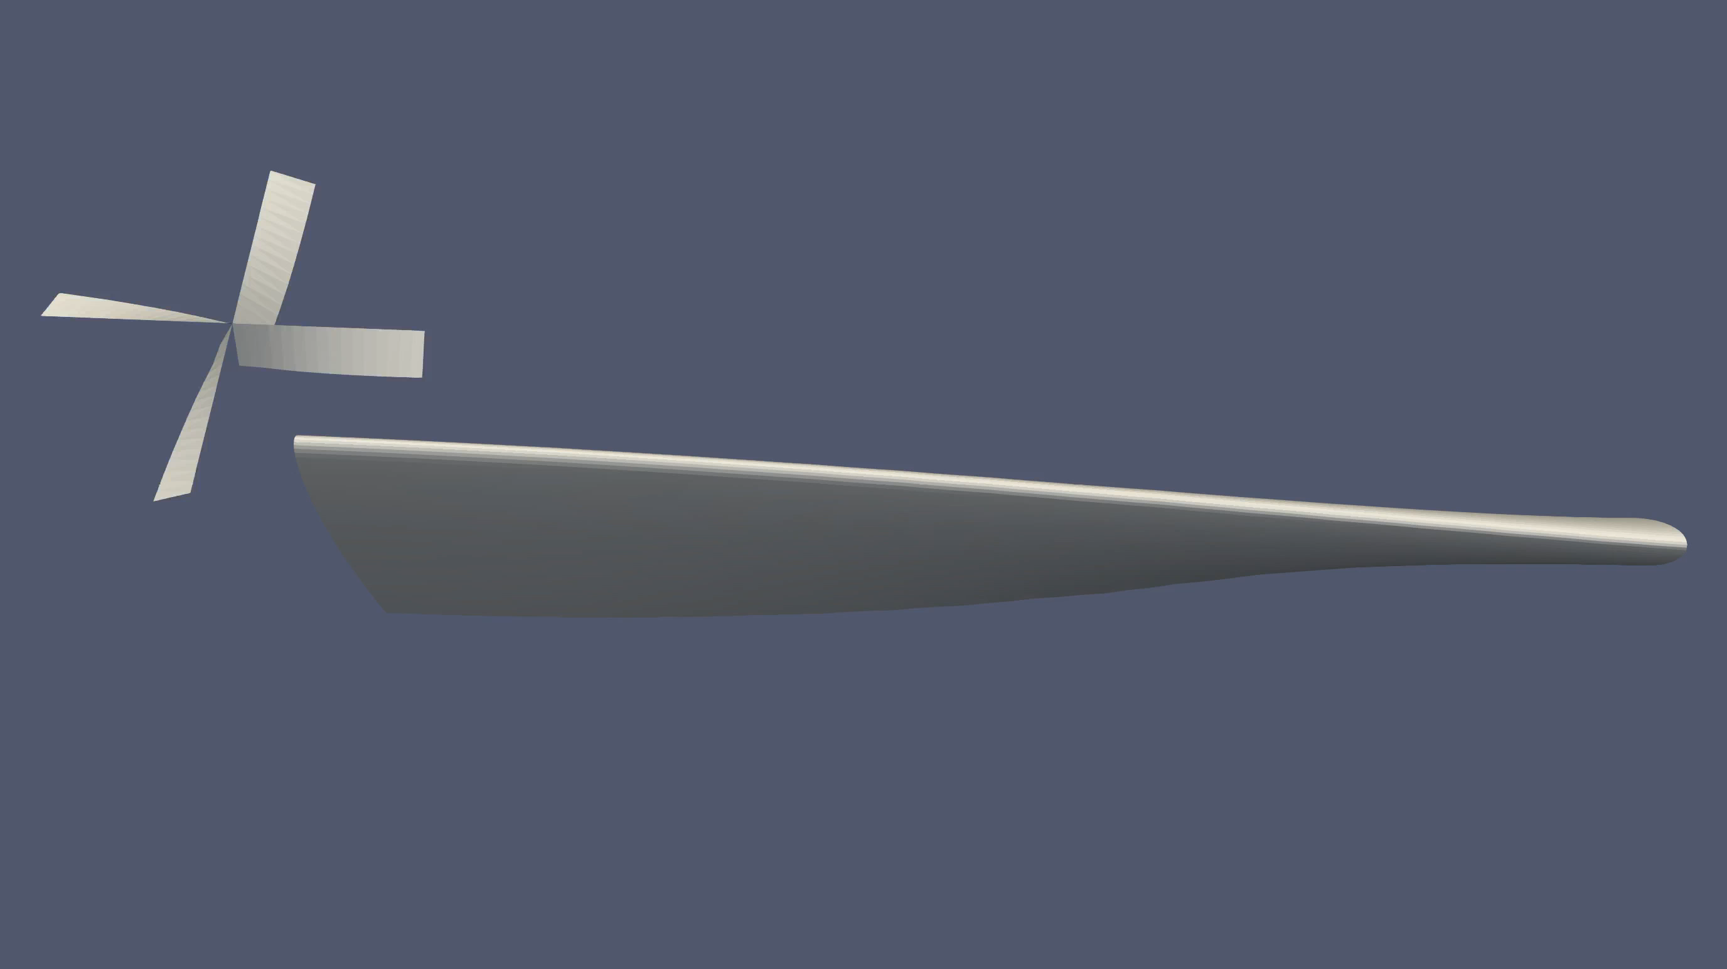
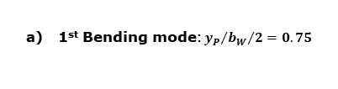
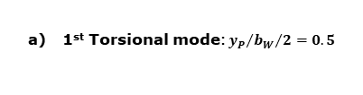
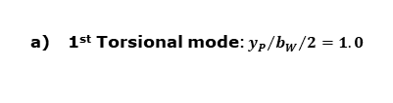
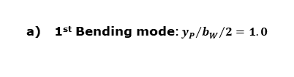
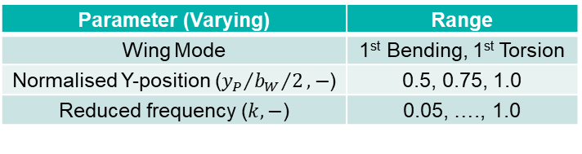
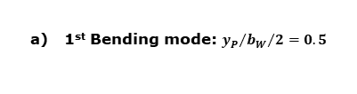
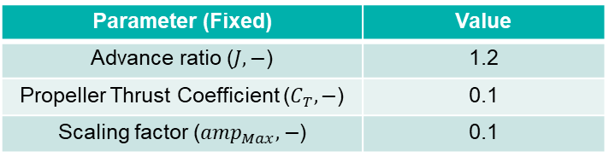
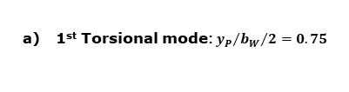
Aerodynamic Investigation: Complex Modes
Rigidly Attached Propeller
Parameter (Fixed) | Value
Advance ratio ($J, −$) | 1.2
Propeller Thrust Coefficient ($C_{T}, −$) | 0.1
Scaling factor (${amp}_{Max}, −$) | 0.1
Parameter (Varying) | Range
Wing Mode | 1st Bending, 1st Torsion
Normalised Y-position (${y_{P}}/{{b_{W}}/2}, −$) | 0.5, 0.75, 1.0
Reduced frequency ($k, −$) | 0.05, …., 1.0
1st Bending mode: ${y_{P}}/{{b_{W}}/2}=0.5$
1st Torsional mode: ${y_{P}}/{{b_{W}}/2}=0.5$
$${amp}_{Max}=0.1: h_{W_{Max−Tip}}=0.1m (h=0.0547)$$
1st Bending mode: ${y_{P}}/{{b_{W}}/2}=0.75$
1st Torsional mode: ${y_{P}}/{{b_{W}}/2}=0.75$
${amp}_{Max}=0.1: α_{W_{Max−Tip}}=0.1rad (α_{W_{Max}}=5.73°)$
1st Bending mode: ${y_{P}}/{{b_{W}}/2}=1.0$
1st Torsional mode: ${y_{P}}/{{b_{W}}/2}=1.0$

Slide 18

Aerodynamic Investigation: Complex Modes
Rigidly Attached Propeller
1st Bending Mode – Lift (top) and Moment (bottom) force variation:
Magnitude (left) and phase (right) representation; $C_{T}=0.1$, ${amp}_{Max}=0.1$
1st Torsional Mode – Lift (top) and Moment (bottom) force variation:
Magnitude (left) and phase (right) representation; $C_{T}=0.1$, ${amp}_{Max}=0.1$
A positive thrust coefficient resulted in positive variations in lift and moment coefficients and phase shifts.
In the bending wing mode:
A moderate increase in $∆C_{L}$ and $∆C_{M}$ compared to inboard propeller locations.
A large increase in $∆ψ_{M}$ at lower $k$ compared to inboard propeller locations.

Slide 19






Conclusions
Pitching/Plunging Wing with Rigidly Attached Propeller
Pitching/Plunging Wing with Flexibly Attached Propeller
Flexible Wing with Rigidly Attached Propeller
Propeller influences the magnitude and phase shift of lift and moment forces, but not overall system behaviour
Aerodynamic response scales with the ratio of propeller pitching amplitude to wing pitching/plunging amplitude
Minimal variations in lift and moment force coefficients ($∆C_{L}$,${∆C}_{M}$) and phase shifts ($∆ψ_{L}$,$∆ψ_{M}$) between the wing-propeller and the standalone wing models across different spanwise propeller locations
Thrusting propeller increases lift and moment force coefficients, with minor phase shift variations
Aerodynamic forces vary linearly with phase shift ($φ_{P}$) between propeller and wing motions
Resonance-like behaviour occurs at a certain reduced frequency ($k$), maximising the propeller’s influence on wing forces
Magnitude variation of the aerodynamic response is independent of $φ_{P}$
Notable differences:
Moderate increase in $∆C_{L}$ and ${∆C}_{M}$for wingtip propeller in the 1st natural bending wing mode, compared to inboard propeller locations
Large increase in $∆ψ_{M}$ at lower $k$ for wingtip propeller in the 1st natural bending wing mode, compared to inboard locations
Wing forces are more sensitive to vertical motions of the propeller
For a fixed amplitude ratio, the system's aerodynamic response increases as $k$ increases

Slide 20
Outlook
CFD verification and wind tunnel testing.
Advance propeller-wing configurations.
Further exploration of flexible propeller-wing attachment models.
Advanced simulation techniques.

Slide 21
Thank you!

Slide 22


Simulation Methodology
Existing Software Tools
DUST
Aerodynamic solver (open source).
Calculates forces based on Potential Flow Theory (no compressibility* or viscous effects).
Models are built using surface panels or lifting line elements.
preCICE
Coupling library (open source).
Used to synchronise data transfer between two or more solvers.
Written in C++, with additional bindings in Python, Fortran, Rust, etc.

Slide 23
Validation Studies
Pitching/Plunging Motions of a Standalone Wing:
Simple wing with 3 different airfoil configurations (NACA 0004, NACA 64₂-a015 and NACA 0024) – FMI simulations performed with wing undergoing pitching and plunging motions at small oscillating amplitudes and frequencies.
Resulting lift and moment transfer functions compared to values obtained from Theodorsen’s Unsteady Thin Airfoil Theory.
Flexible Wing and its Natural Wing Modes:
(Eigen) Frequencies of the first 4 natural wing modes of the Goland Wing compared to existing research.
FMI simulations performed at a fixed oscillating amplitude and different reduced frequencies.
Resulting lift and moment coefficients and phase shifts analysed.
Propeller-Wing (Stationary) Interaction:
Existing propeller-wing interaction verified using Veldhuis’ thesis as a framework.
Propeller advance ratio, rotation direction, spanwise location and relative inclination to the wing varied.
Resulting lift and drag (inviscid) coefficient plots as well as spanwise lift distributions compared.

Slide 24


Validation Studies
Pitching and Plunging Motions of a Standalone Wing
Parameter (Fixed) | Value
Freestream velocity ($u_{∞}, ms^{−1}$) | 50
Freestream density ($ρ_{∞}, kgm^{−3}$) | 1.2
Parameter (Varying) | Range
Wing pitch amplitude ($α_{W_{Max}}, deg$) | 1, 2, 4
Normalised plunge amplitude ($h, −$) | 0.025, 0.05, 0.1
Reduced frequency ($k, −$) | 0.101, …., 1.005
FMI simulations performed on pitching and plunging wings at small oscillating amplitudes and reduced frequencies to maintain linearity.
Plots of lift and moment transfer functions for 3 different airfoil configurations show similar trends to theoretical values, indicating similar behaviour.
Differences from theoretical values increase for increasing airfoil thickness as 3-dimensional effects grow larger.

Slide 25




Fundamentals and Validation Studies
Natural Modes of a Flexible Wing
The Goland Wing is a flexible wing commonly-used in aeroelastic studies and has a lot of research done upon it.
1st natural wing mode
(Pure Bending)
2nd natural wing mode
(Pure Torsional)
3rd natural wing mode
(Bending-Torsion)
4th natural wing mode
(Bending-Torsion)
Mode Shape | Durmuş | Bennamia and Baderredine | Savino and Cocco
1 (Bending Dominant) | 49.58 | 49.24 | 48.13
2 (Torsional Dominant) | 97.28 | 99.19 | 95.57
3 (Bending+Torsion) | 248.58 | 246.53 | 242.15
4 (Bending+Torsion) | 356.32 | - | 344.26
Current Model
48.07
95.56
242.69
344.91

Slide 26



Validation Studies
Propeller-Wing (Stationary) Interaction – Rotation Direction
Parameter (Varying) | Range
Wing angle of attack $\left(α_{W}, deg\right)$ | 1
Advance ratio $\left(J, −\right)$ | 0.9 (LT), 0.7 (HT)
Propeller Thrust Coefficient $\left(C_{T}, −\right)$ | 0.133, 0.235

Slide 27


Validation Studies
Propeller-Wing (Stationary) Interaction – Rotation Direction
Parameter (Varying) | Range
Wing angle of attack $\left(α_{W}, deg\right)$ | 0, 2, 4, 6, 8, 10
Rotation direction | IU, OU
Advance ratio $\left(J, −\right)$ | 0.85
Normalised Y-position $\left({{y_{P}}/{b_{W}}}/2, −\right)$ | 0.469
Propeller relative inclination $\left(α_{P→W}, deg\right)$ | 0.0
In both IU and OU rotation cases, $C_{L}$ increases compared to the standalone wing case.
Slope of $C_{L}$ vs $α_{W}$ curve for IU was larger than that of OU case.
Spanwise $C_{L}$ distribution from Veldhuis’ thesis matched FMI simulation results very closely.

Slide 28


Validation Studies
Propeller-Wing (Stationary) Interaction – Advance Ratio
Parameter (Varying) | Range
Wing angle of attack $\left(α_{W}, deg\right)$ | 0, 2, 4, 6, 8, 10
Rotation direction | IU
Advance ratio $\left(J, −\right)$ | 0.81, 0.95,1.11
Normalised Y-position $\left({{y_{P}}/{b_{W}}}/2, −\right)$ | 0.469
Propeller relative inclination $\left(α_{P→W}, deg\right)$ | 0.0
As $J$ increases, $C_{L}$ decreases.
At higher $α_{W}$ positions, the difference in $C_{L}$ grew larger.
At certain $J$, the propeller was thrusting and yet the $C_{L}$ for the wing-propeller model was lower than that of the standalone wing.

Slide 29


Validation Studies
Propeller-Wing (Stationary) Interaction – Spanwise Location
Parameter (Varying) | Range
Wing angle of attack $\left(α_{W}, deg\right)$ | 4.2
Rotation direction | IU
Advance ratio $\left(J, −\right)$ | 1.07
Normalised Y-position $\left({{y_{P}}/{b_{W}}}/2, −\right)$ | 0.3, …., 1.0
Propeller relative inclination $\left(α_{P→W}, deg\right)$ | 0.0
For propeller positions closer to the wingtip, $C_{L}$ increased, while $C_{D_{inv}}$ decreased.
For conventional propeller spanwise positions, ${0.3≤{y_{P}}/{b_{W}}}/2≤0.5$, ${C_{L}}/{C_{D_{inv}}}$ did not vary too much.

Slide 30




Validation Studies
Propeller-Wing (Stationary) Interaction – Propeller Inclination
Parameter (Varying) | Range
Wing angle of attack $\left(α_{W}, deg\right)$ | 4.2, 8.4
Rotation direction | 0.92
Advance ratio $\left(J, −\right)$ | IU
Normalised Y-position $\left({{y_{P}}/{b_{W}}}/2, −\right)$ | 0.469
Propeller relative inclination $\left(α_{P→W}, deg\right)$ | -24, …., 14
$α_{W}$ = 4.2°
As $α_{P→W}$ increased, $C_{L}$ decreased, while $C_{D_{inv}}$ increased.
Lower propeller inclinations are preferable for better aerodynamic performance.
$α_{W}$ = 8.4°

Slide 31




Aerodynamic Investigation: Simple Motions
Model Description
Wing Parameter | Value
Airfoil | NACA 64₂-a015
Planform | Rectangular
Wingspan ($b_{W}, m$) | 1.28
Wing chord ($c_{W}, m$) | 0.24
Propeller Parameter | Value
Airfoil | NACA 0012
Number of blades | 4
Propeller radius ($R, m$) | 0.118
Propeller chord ($c_{P}, m$) | 0.053
Propeller twist ($θ_{P}, deg$) | 48
Propeller blade pitch angle ($β_{0.75}, deg$) | 25
Simulation Parameter (Fixed) | Value
Freestream velocity ($u_{∞}, ms^{−1}$) | 50
Freestream density ($ρ_{∞}, kgm^{−3}$) | 1.2
Normalised Y-position (${y_{P}}/{{b_{W}}/2}, −$) | 0.5
Normalised Z-position (${z_{P}}/R, −$) | 0.0
Normalised X-position (${x_{P}}/{c_{W}}, −$) | -0.841

Slide 32

Aerodynamic Investigation: Simple Motions
Model Description
$C_{L}$ vs $α$ plot is linear in the chosen $α$ range.
$C_{L}$ vs $α$ and $C_{D_{inv}}$ vs $α$ plots are symmetric (symmetric airfoil, $C_{D_{inv}}$ comprises of just induced drag ($C_{D_{i}}$)).
Propeller performance curve shows a decrease in $C_{T}$ for an increase in $J$.
Windmilling $C_{T}$ is around 1.12 (for the chosen propeller at the given simulation settings).
Veldhuis Wing - $C_{L}$ and $C_{D_{inv}}$ vs $α_{W}$
Propeller 1 - $C_{T}$ vs $J$

Slide 33




Aerodynamic Investigation: Complex Modes
Model Description
Propeller Parameter | Value
Airfoil | NACA 0012
Number of blades | 4
Propeller radius ($R, m$) | 0.762
Propeller chord ($c_{P}, m$) | 0.1863
Propeller twist ($θ_{P}, deg$) | 32.71
Propeller blade pitch angle ($β_{0.75}, deg$) | 34
Wing Parameter | Value
Airfoil | NACA 0012
Planform | Rectangular
Wingspan ($b_{W}, m$) | 6.096
Wing chord ($c_{W}, m$) | 1.8288
Simulation Parameter (Fixed) | Value
Freestream velocity ($u_{∞}, ms^{−1}$) | 50
Freestream density ($ρ_{∞}, kgm^{−3}$) | 1.225
Normalised Z-position (${z_{P}}/R, −$) | 0.0
Normalised X-position (${x_{P}}/{c_{W}}, −$) | -0.5

Slide 34


Aerodynamic Investigation: Complex Modes
Model Description
Propeller performance curve shows a decrease in $C_{T}$ for an increase in $J$.
Windmilling $C_{T}$ is around 1.42 (for the chosen propeller at the given simulation settings).
Maximum thrust about 70%-90% of propeller radius.
Propeller 2 - $C_{T}$ vs $J$
Propeller 2 - $T$ vs $r/R$

